Slide 1

Mapping Social Determinants of Health in Utah: A Data-driven Approach for Public Health and Clinical Decision-making
Sunho Im • Joshua Kawasaki • Kristin Knippenberg • Mahony Reategui-Rivera • L Weaver
GitHub https://github.com/lwynholds/BMI6016_SDOH
Group 4, BMI 6016 Data Wrangling, Spring 2025
Department of Biomedical Informatics
University of Utah School of Medicine
© UNIVERSITY OF UTAH HEALTH
April 21, 2025
Notes:
Mahony + Sunho

Slide 2
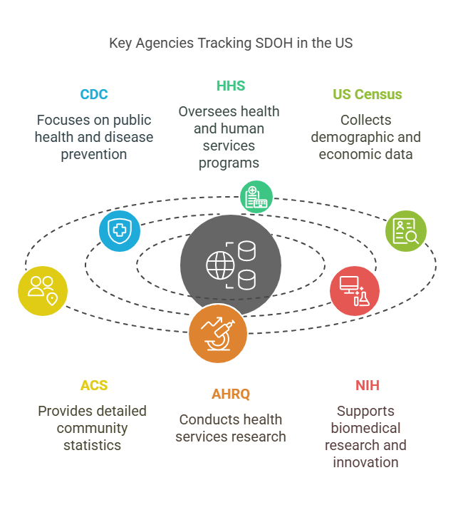
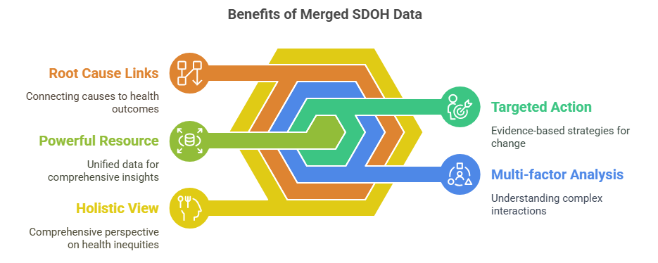
BACKGROUND AND MOTIVATION
Social Determinants of Health (SDOH) are “the circumstances in which people are born, grow up, live, work and age, and the systems put in place to deal with illness. These circumstances are in turn shaped by a wider set of forces: economics, social policies, and politics"
In 2018, Cantor et al. published their Factors Affecting Communities and Enabling Targeted Services (FACETS) open-data model
to standardize and compile SDOH-related data at the census-tract level in New York City, and
to integrate community-level determinants with patient health records in clinical settings
We propose to develop a FACETS-based model tailored to the state of Utah, by integrating Utah-specific SDOH data, including environmental data, into a framework, we aim to provide a comprehensive tool for assessing community-level health determinants to support informed public health interventions and patient-level clinical decision-making
Group 4, BMI 6016 Data Wrangling, Spring 2025
Department of Biomedical Informatics
University of Utah School of Medicine
© UNIVERSITY OF UTAH HEALTH
April 21, 2025
Notes:
Mahony + Sunho
First conceptualized by the World Health Organization (WHO), SDOH have been widely recognized in health research for approximately 25 years

Slide 3
PROJECT OBJECTIVES
To standardize Utah’s SDOH data at the US census-tract level by integrating multiple sources of publicly available and state-specific data, using:
ACS and US Census Bureau, CDC, Environmental Protection Agency (EPA), and US Department of Agriculture Food Access Research Atlas (USDA) data (data sources from the original FACETS study that are also relevant to Utah)
State datasets from the Utah Department of Health and Human Services
State SDOH variables not otherwise specified that are particular or pertinent to Utah (e.g., urban/rural, electoral participation)
Temporal, categorical, or spatial crosswalks, where necessary
To create an interoperable dataset of census tracts, within which an individual patient’s address can be mapped to a Utah FACETS characterization of SDOH context
To characterize disparities in health outcomes based on the intersection of air quality with other environmental health factors and SDOH.
To give context to any individual patient’s health status and assist patients and providers in deciding how best to improve that patient’s health.
Group 4, BMI 6016 Data Wrangling, Spring 2025
Department of Biomedical Informatics
University of Utah School of Medicine
© UNIVERSITY OF UTAH HEALTH
April 21, 2025
Notes:
Mahony + Sunho

Slide 4






DATASETS
PM_{2.5} Max Value • Respiratory hazard/cancer risk (2020)
Social Vulnerability Index
SVI percentile ranking • English proficiency (2020)
American Community Survey
Census tract geodata • Urban-Area classification (2020)
Law enforcement and municipal geodata • Crime (2022)
Asthma prevalence (2022)
Total population • Citizenship • Racial/Ethnic diversity • Unemployment • Health insurance status • Housing • Education • Poverty • Household income • Walkability • GINI Index of Inequality (2020)
Group 4, BMI 6016 Data Wrangling, Spring 2025
Department of Biomedical Informatics
University of Utah School of Medicine
© UNIVERSITY OF UTAH HEALTH
April 21, 2025
Notes:
All variables are from 2020, except for asthma and crime, which are from 2022, and the law-enforcement (2024) and municipal (2025) base maps, which are continuously updated.
L says: make an argument here that these variables are not 'fast moving' and therefore mixing across a few different years should not affect the meaning of the results ...

Slide 5

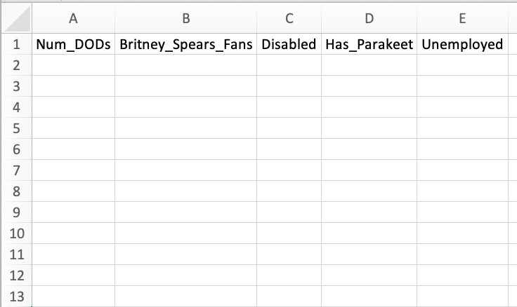
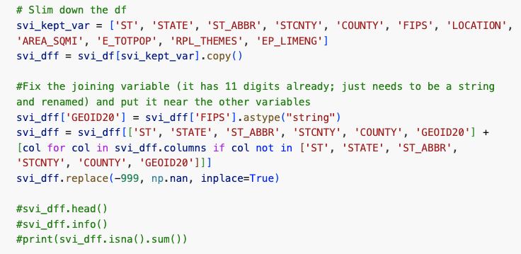


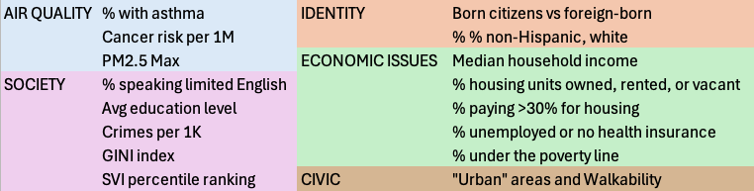
DATA PROCESSING AND WRANGLING
Remove unwanted and redundant attributes and anomalies
Merge, join, and transform variables into domains, themes, and layers.
First a lot of this …
YEET
BYE
+
=
CDC, USDA EPA CSVs
AHRQ_SDOH CSVs (338 variables)
Turn jurisdictional and county data into census tracts with CROSSWALKS
Tract_a
… with this as the goal …
Tract_b
Tract_c
Tract_d
Jd_1
Jd_2
Jd_3
Jd_4
Tract_e
Tract_f
Law Enforcement Jurisdiction
Census Tract
Tract_g
Shapefiles .cpg, .dbf, .prj, .shp, .shx (716 records)
Tract_h
Tract_i
Tract_j
Tract_k
Group 4, BMI 6016 Data Wrangling, Spring 2025
Department of Biomedical Informatics
University of Utah School of Medicine
© UNIVERSITY OF UTAH HEALTH
April 21, 2025
Notes:
Kristin + Josh (KK SAYS, I'M COPYING THIS OVER TO THE DATA WRANGLING SLIDE TOO)
Getting CSV files from different sources
Getting geospatial data
Examined data types
Converted objects to strings
Pare down the data to only keep the necessary columns
Perform calculations to get usable data (ex. percentage of racial make-up) – standardize/scale data
Confirm same data type for geospatial data
Convert latitude and longitude to ‘points’
Perform a look-up with our geospatial data frame to see which census tract/county it’s in
Go through the geospatial data to add in the relevant geographical data/identifiers
Join the dataframes

Slide 6
Results: Variable descriptions
Dimensions of the DF: (716, 38)
Variables | Descriptions |  | Variables (continued) | Descriptions (continued)
GEOID20 | Census tract identifier (2020) |  | ACS_PCT_UNINSURED | % of population without health insurance
ACS_PCT_CTZ_US_BORN | % of U.S.-born citizens |  | ACS_PCT_PERSON_INC_BELOW99 | % of people with income below the poverty line
ACS_PCT_FOREIGN_BORN | % of foreign-born residents |  | ACS_GINI_INDEX | Income inequality index
ACS_PCT_WHITE | % identifying as white |  | PCT_EDUCATION_WT_AVG | Weighted average of educational attainment
ACS_PCT_NONHISP | % non-Hispanic |  | CASTHMA_PCT | % of population with asthma
ACS_MEDIAN_HH_INC | Median household income |  | RPL_THEMES | CDC Social Vulnerability Index score
ACS_PCT_OWNER_HU | % owner-occupied housing units |  | EP_LIMENG | % of people with limited English proficiency
ACS_PCT_OWNER_HU_COST_30PCT | % owners with housing costs > 30% of income |  | UA_POP | Population in Census-designated "Urban Areas"
ACS_PCT_RENTER_HU | % renter-occupied housing units |  | ACS_PCT_WALK_2WORK | % of workers walking to work
ACS_PCT_RENTER_HU_COST_30PCT | % renters with housing costs > 30% of income |  | 1st Max Value | PM25 highest μg/m³ at monitoring site
ACS_PCT_VACANT_HU | % vacant housing units |  | TCPRM | Total cancer risk (per million)
ACS_PCT_UNEMPLOY | % unemployed individuals |  | TOT_CRIME_P1K | Total crimes (per 1000)
Group 4, BMI 6016 Data Wrangling, Spring 2025
Department of Biomedical Informatics
University of Utah School of Medicine
© UNIVERSITY OF UTAH HEALTH
April 21, 2025
Notes:
Mahony + Sunho
Most missing is the percentage of asthma, UA_POP (Urban Areas - only for census-defined "Urban Areas." Any tracts without data are assumed "rural."), and the Walking index

Slide 7
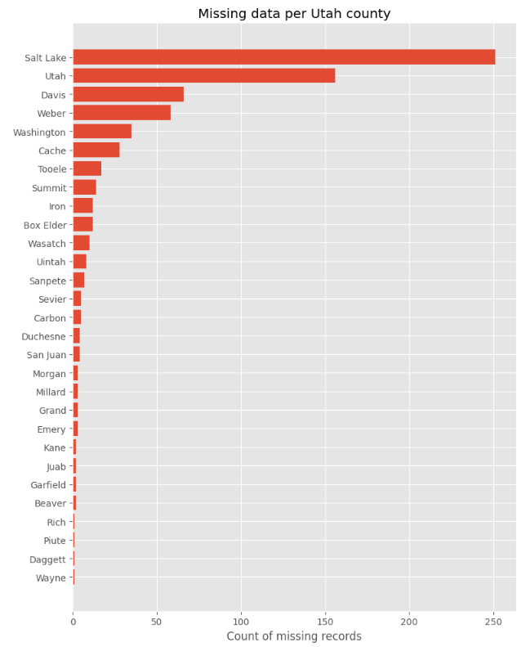
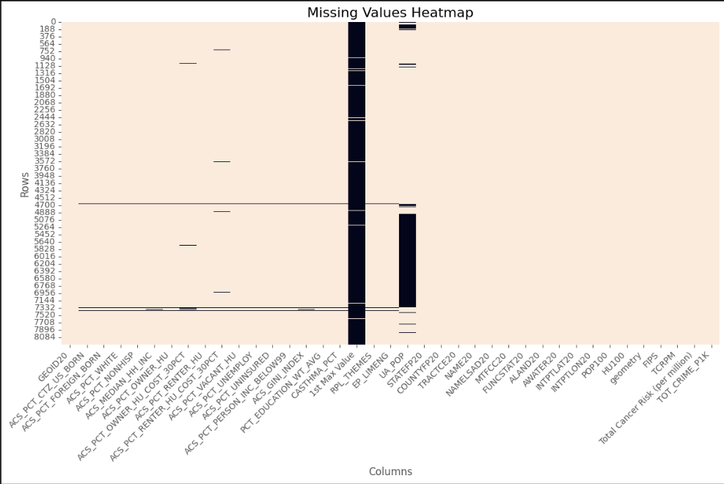
Results: Missing data
Group 4, BMI 6016 Data Wrangling, Spring 2025
Department of Biomedical Informatics
University of Utah School of Medicine
© UNIVERSITY OF UTAH HEALTH
April 21, 2025
Notes:
Mahony + Sunho
Most missing is the percentage of asthma, UA_POP (Urban Areas - only for census-defined "Urban Areas." Any tracts without data are assumed "rural."), and the Walking index

Slide 8
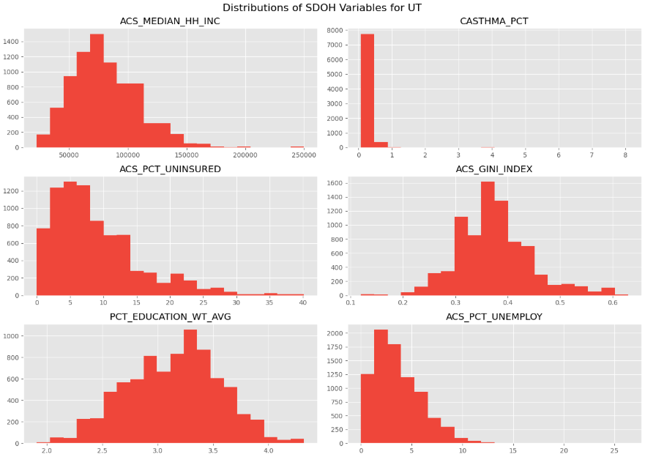
Results: EDA by state level
Median household income
% of population with asthma
% of population without
health insurance
Income inequality index
Weighted average of educational attainment
% unemployed individuals
Group 4, BMI 6016 Data Wrangling, Spring 2025
Department of Biomedical Informatics
University of Utah School of Medicine
© UNIVERSITY OF UTAH HEALTH
April 21, 2025
Notes:
Mahony + Sunho

Slide 9
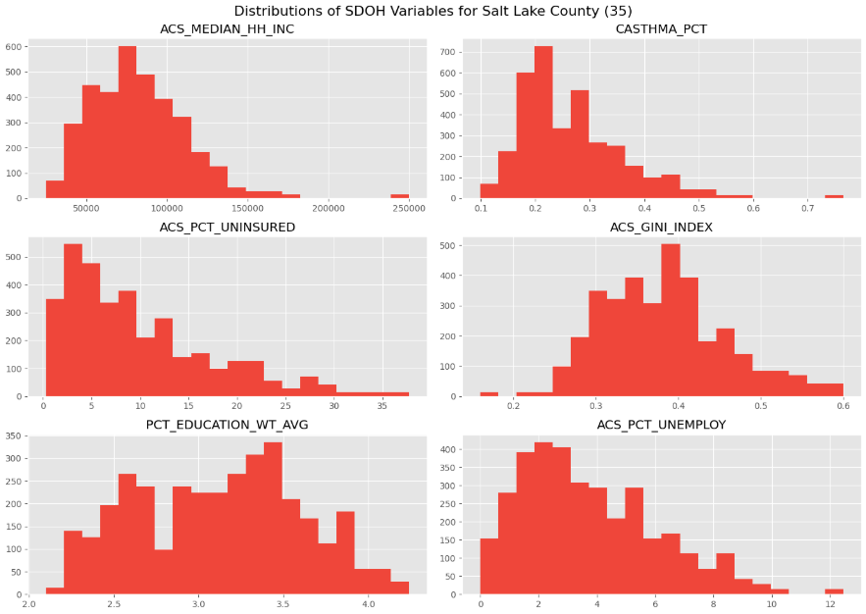
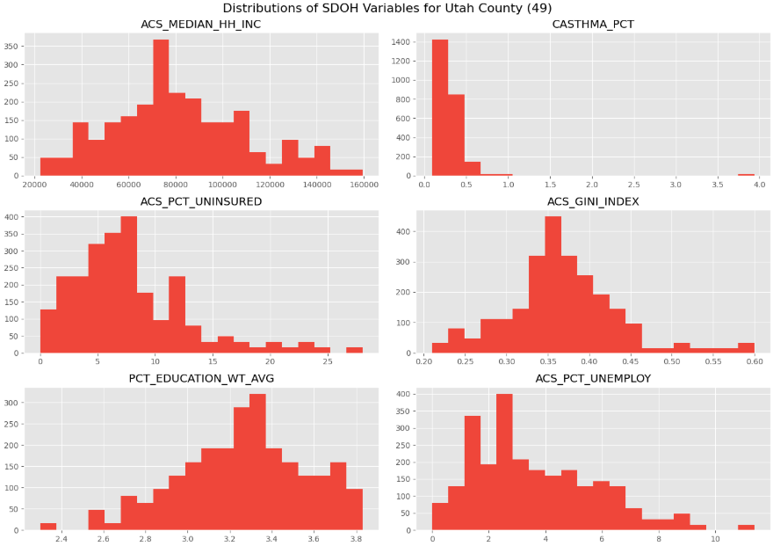
Results: EDA by County level
Median household income
% of population with asthma
Median household income
% of population with asthma
% of population without
health insurance
Income inequality index
% of population without
health insurance
Income inequality index
Weighted average of educational attainment
% unemployed individuals
Weighted average of educational attainment
% unemployed individuals
Group 4, BMI 6016 Data Wrangling, Spring 2025
Department of Biomedical Informatics
University of Utah School of Medicine
© UNIVERSITY OF UTAH HEALTH
April 21, 2025
Notes:
Median household income ($)
Percentage with asthma
Percentage uninsured
GINI index (Income inequality)
Cancer risk
Walking index

Slide 10

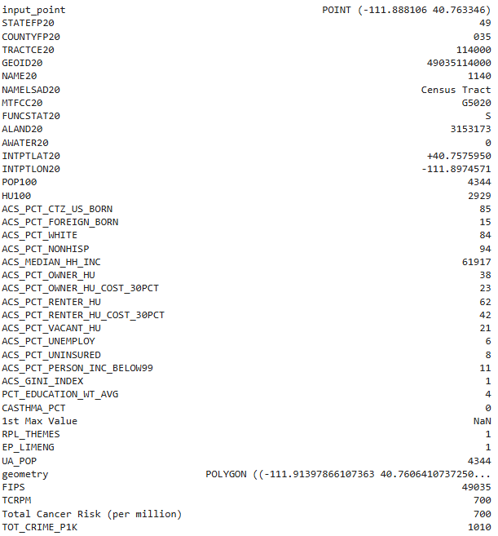
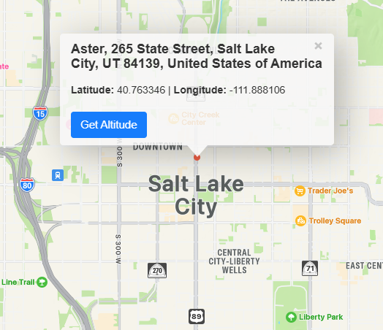
Data Analysis
Inputting geographic coordinates within Utah allows us to identify the relevant census tract and retrieve the associated raw SDOH variables.
Here is an example for SLC
Group 4, BMI 6016 Data Wrangling, Spring 2025
Department of Biomedical Informatics
University of Utah School of Medicine
© UNIVERSITY OF UTAH HEALTH
April 21, 2025
Notes:
Median household income ($)
Percentage with asthma
Percentage uninsured
GINI index (Income inequality)
Cancer risk
Walking index

Slide 11
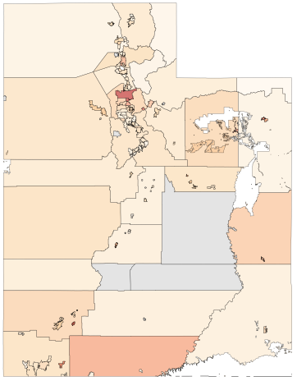
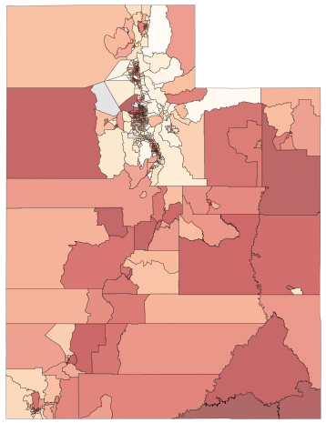
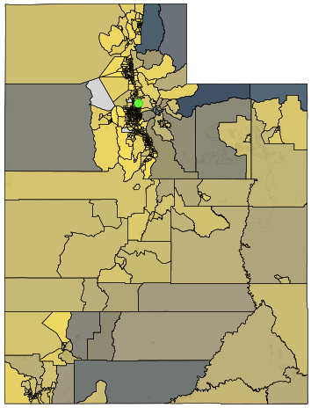
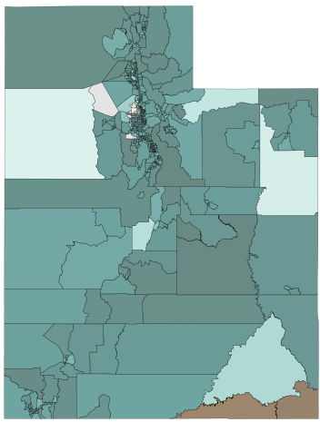
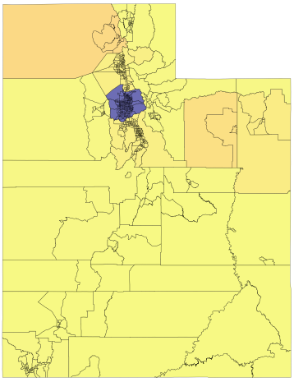
Maps
By putting geospatial shape files into GeoDataFrames as basemaps, then linking each variable mostly by GEOID20 and assigning colormaps to the range of values, we made HEATMAPS:
Group 4, BMI 6016 Data Wrangling, Spring 2025
Department of Biomedical Informatics
University of Utah School of Medicine
© UNIVERSITY OF UTAH HEALTH
April 21, 2025
Notes:
KK, SI
ANIMATED!!! CLICK ON SLIDE TO BEGIN THE ANIMATION.
Crime rates -- % white race -- SVI ranking -- respiratory hazard/cancer risk – and the last one is 3 housing variables layered together, with the green dot plotting the University of Utah.
Generally, darker colors indicate worse outcomes, EXCEPT for the racial and other identity maps. For the identity maps, darker means more uniformity of identity, while lighter colors indicate more variability.

Slide 12
Conclusions
Data is readily available from public sources, but it requires varying degrees of data wrangling to compile them into one source that facilitates interoperability.
Mapping datasets that were originally compiled at the city or county level into census tracts leaves artifacts in the data
This unified dataset, created through data compilation and mapping, enables aggregate analysis, GIS visualization, and comparisons of individual factor impact on clinical outcomes.
This CSV dataset represents a significant first move towards standardizing and compiling SDOH data in an open architecture. This will allow for a better understanding of a patient's situation and improve decision-making in care planning.
Group 4, BMI 6016 Data Wrangling, Spring 2025
Department of Biomedical Informatics
University of Utah School of Medicine
April 21, 2025
Notes:
LW, JK

Slide 13
Potholes in the Information superhighway: Missing data
Group 4, BMI 6016 Data Wrangling, Spring 2025
Department of Biomedical Informatics
University of Utah School of Medicine
© UNIVERSITY OF UTAH HEALTH
April 21, 2025
Notes:
Mahony + Sunho
Most missing is the percentage of asthma, UA_POP (Urban Areas - only for census-defined "Urban Areas." Any tracts without data are assumed "rural."), and the Walking index

Slide 14
references
Social Determinants of Health (SDOH) Database (https://www.ahrq.gov/sdoh/data-analytics/sdoh-data.html)
Behavioral Risk Factor Surveillance System (https://www.cms.gov/About-CMS/Agency-Information/OMH/resource-center/hcps-and-researchers/data-tools/sgm-clearinghouse/brfss)
NaNDA (National Neighborhood Data Archive) (https://nanda.isr.umich.edu)
Braveman, P., Egerter, S., & Williams, D. R. (2011). The social determinants of health: coming of age. Annu Rev Public Health, 32, 381-398. (https://doi.org/10.1146/ annurev-publhealth-031210-101218)
Braveman, P., & Gottlieb, L. (2014). The social determinants of health: it's time to consider the causes of the causes. Public Health Rep, 129 Suppl 2(Suppl 2), 19-31. https://doi.org/10.1177/00333549141291S206
Canaday, F. T., Georas, S. N., & Croft, D. P. (2024). Examining the impact of air pollution, climate change, and social determinants of health on asthma and environmental justice. Curr Opin Pulm Med, 30(3), 276-280. (https://doi.org/10.1097/MCP.0000000000001065)
Cantor, M. N., Chandras, R., & Pulgarin, C. (2018). FACETS: using open data to measure community social determinants of health. J Am Med Inform Assoc, 25(4), 419-422. (https://doi.org/10.1093/jamia/ocx117)
Cook, Q., Argenio, K., & Lovinsky-Desir, S. (2021). The impact of environmental injustice and social determinants of health on the role of air pollution in asthma and allergic disease in the United States. J Allergy Clin Immunol, 148(5), 1089-1101 e1085. (https://doi.org/10.1016/j.jaci.2021.09.018)
Gao, C., Sanchez, K. M., & Lovinsky-Desir, S. (2023). Structural and Social Determinants of Inequitable Environmental Exposures in the United States. Clin Chest Med, 44(3), 451-467. (https://doi.org/10.1016/j.ccm.2023.03.002)
Marmot, M. (2005). Social determinants of health inequalities. Lancet, 365(9464), 1099-1104. (https://doi.org/10.1016/S0140-6736(05)71146-6)
Marmot, M., Allen, J., Bell, R., Bloomer, E., Goldblatt, P., Consortium for the European Review of Social Determinants of, H., & the Health, D. (2012). WHO European review of social determinants of health and the health divide. Lancet, 380(9846), 1011-1029. (https://doi.org/10.1016/S0140-6736(12)61228-8)
Group 4, BMI 6016 Data Wrangling, Spring 2025
Department of Biomedical Informatics
University of Utah School of Medicine
© UNIVERSITY OF UTAH HEALTH
April 21, 2025

Slide 15
References, continued
Marmot, M., Friel, S., Bell, R., Houweling, T. A., Taylor, S., & Commission on Social Determinants of, H. (2008). Closing the gap in a generation: health equity through action on the social determinants of health. Lancet, 372(9650), 1661-1669. https://doi.org/10.1016/S0140-6736(08)61690-6
McRoy, L., Rust, G., & Xu, J. (2017). Factors Associated with Asthma ED Visit Rates among Medicaid-enrolled Children: A Structural Equation Modeling Approach. AIMS Med Sci, 4(1), 71-82. https://doi.org/10.3934/medsci.2017.1.71
Office of Disease Prevention and Health Promotion. (2024, Jan 1). Social Determinants of Health Literature Summaries. US Department of Health and Human Services. Retrieved February 16 from https://odphp.health.gov/healthypeople/priority-areas/social-determinants-health/literature-summaries#block-sdohinfographics
The World Health Organization (WHO). (2003). Social Determinants of Health: The Solid Facts, 2nd edition. Retrieved from https://iris.who.int/handle/10665/326568
Zhu, G., Wen, Y., Cao, K., He, S., & Wang, T. (2024). A review of common statistical methods for dealing with multiple pollutant mixtures and multiple exposures. Front Public Health, 12, 1377685. https://doi.org/10.3389/fpubh.2024.1377685
Group 4, BMI 6016 Data Wrangling, Spring 2025
Department of Biomedical Informatics
University of Utah School of Medicine
© UNIVERSITY OF UTAH HEALTH
April 21, 2025

